Slide 1
Chocolate Meets Data
PALAK DAVE

Slide 2
Project Overview
In an increasingly competitive chocolate market, Ghirardelli strives to maintain and grow its market position by leveraging data analytics for informed decision-making. This project presents the design, development, and insights generated from an interactive sales dashboard built in Power BI that consolidates key sales, shipment, and profitability metrics. The dashboard enables real-time monitoring of performance, trend analysis, and supports strategic business actions to optimize operations and profitability at Ghirardelli. Notably, the dashboard reveals that markets in Canada, India, and New Zealand are leading in sales and shipments, highlighting their critical importance to Ghirardelli’s growth strategy.

Slide 3
Business Alignment
To align with Ghirardelli's business goals, the project began with defining comprehensive objectives focused on:
Accurately measuring sales volume and revenue to evaluate business health
Tracking shipments and logistics efficiency to identify bottlenecks
Measuring profitability at granular product and shipment levels
Providing actionable insights through interactive visuals
Comparing performance over time (Month on Month & Year on Year changes)
The ability to quantify these factors is critical to support Ghirardelli’s market growth and supply chain optimization strategies, with targeted attention to high-performing regions such as Canada, India, and New Zealand.

Slide 4
Data Sources & Integration Process
The dashboard integrates multiple Ghirardelli data sources which include:
Sales Transactions: Detailed records of sales with product-level granularity, quantities, sales dates, and revenue
Shipment Logs: Information on shipped box counts, shipment dates, and transportation costs specific to Ghirardelli products
Product Attributes: Ghirardelli product categories, pricing, and cost structures

Slide 5
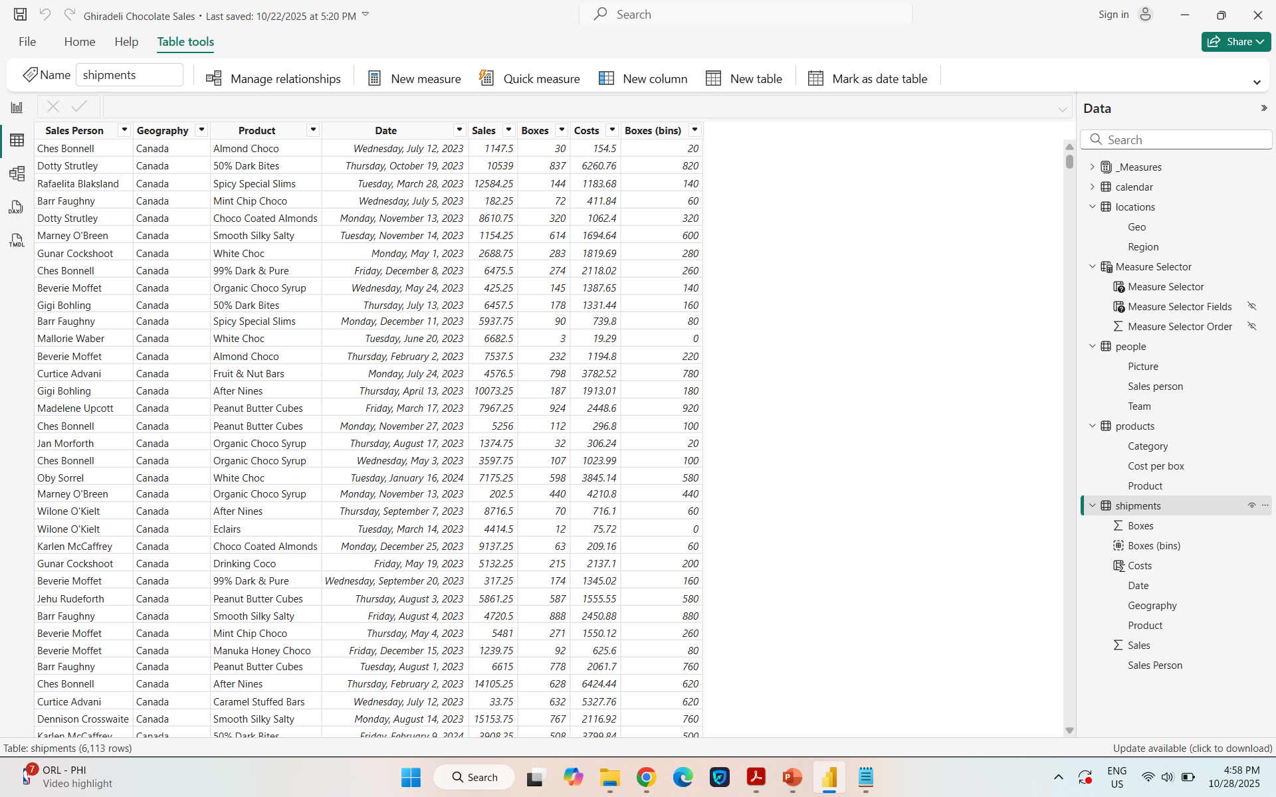
Data Preparation & Validation
Maintaining clean, reliable data was a vital part of the project. This stage covered:
Removing Duplicate Records
Handling Missing Data
Standardization of formats, currencies, and identifiers
Validation through reconciliation with source systems
These steps ensured the data feeding into KPIs and dashboards was high quality, increasing confidence in the findings.

Slide 6
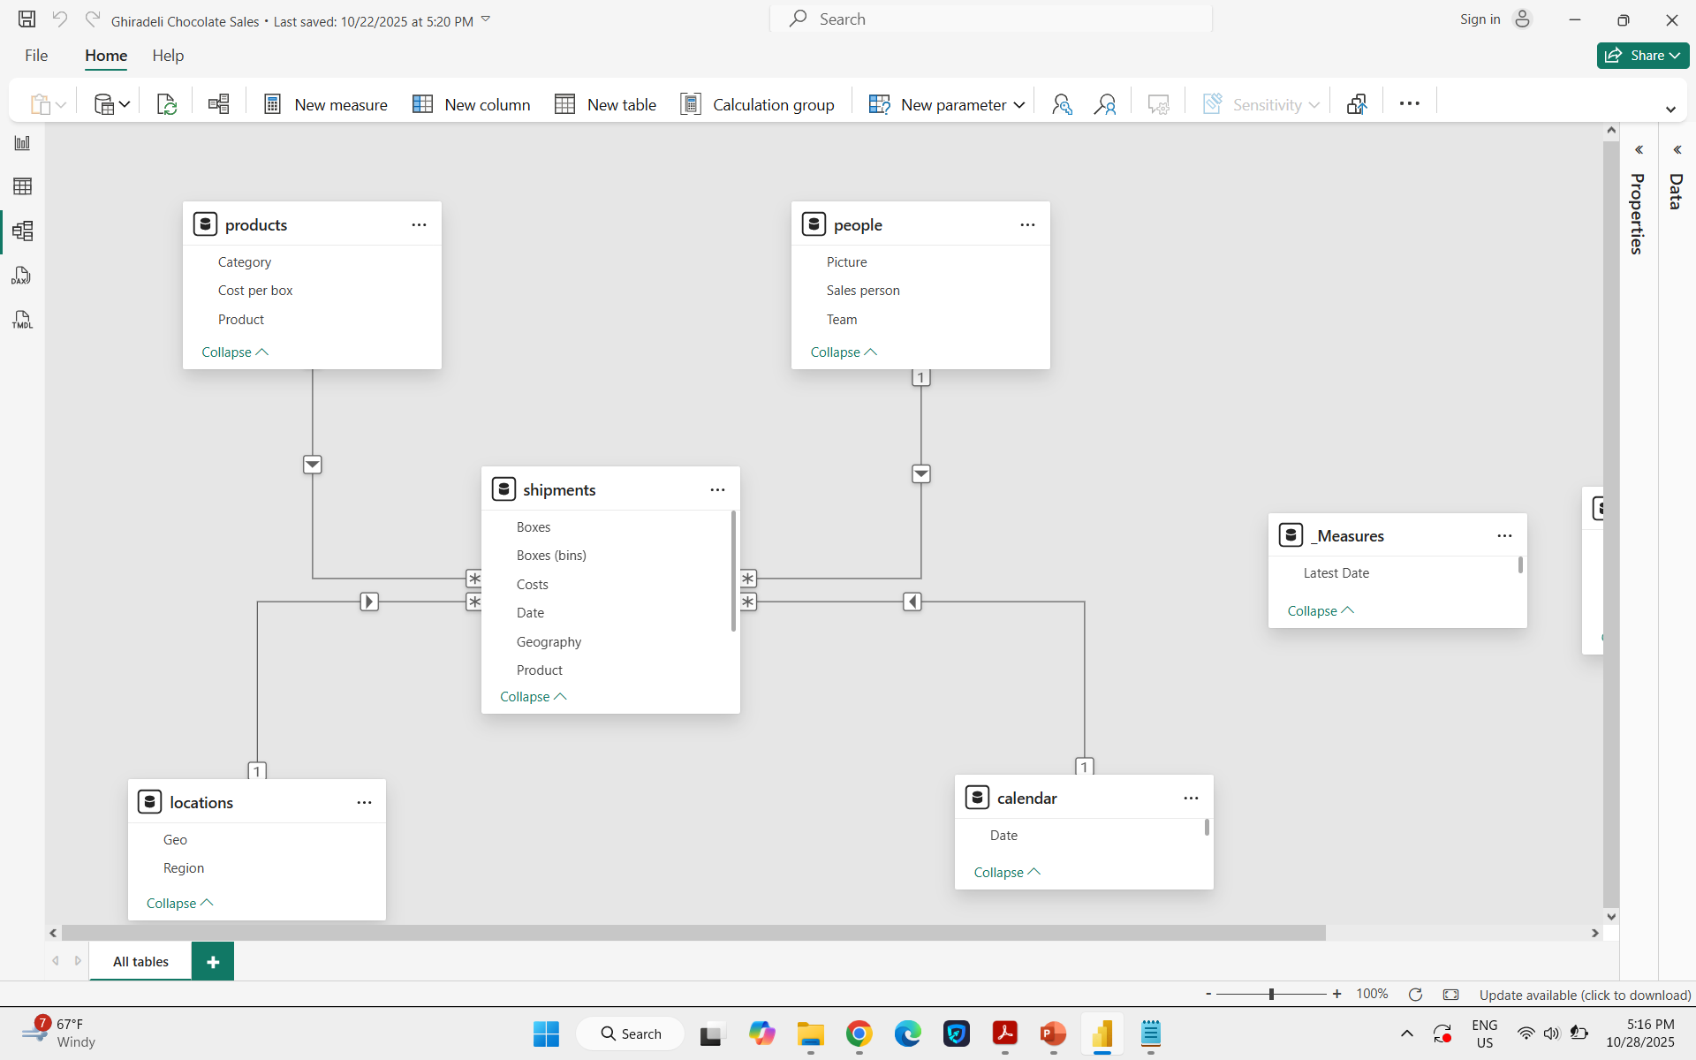
Schema Design
A star schema architecture was developed to optimize Power BI performance and analytical flexibility. The layout includes:
Fact Table: Central repository of Ghirardelli sales, shipment volumes, costs, and profit figures
Dimension Tables: Date, Product, Customer, and Region data supporting flexible filtering and analysis

Slide 7
KPI Framework
Key Performance Indicators (KPIs) were curated to capture Ghirardelli’s performance priorities:
Total Sales Revenue
Total Boxes Shipped
Total Shipments
Total Cost
Total Profit and Profit Percentage
Low Box Shipments (LBS) & LBS %
Month-on-Month and Year-on-Year Growth

Slide 8


Slide 9
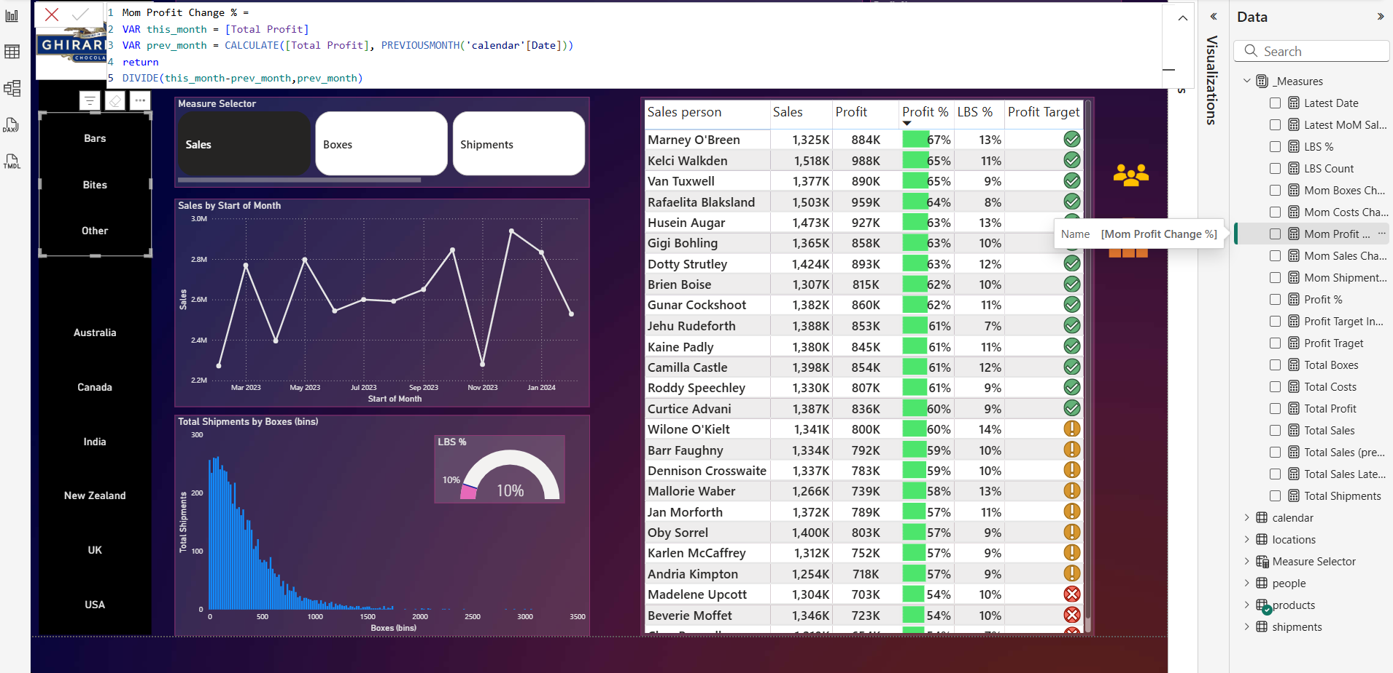
Temporal Analysis Implementation
To analyze trends and seasonality, advanced DAX-driven time intelligence was applied:
Month-on-Month metrics to spot short-term variations
Year-on-Year comparisons for long-term growth tracking

Slide 10
Visual Design & Dashboard Architecture
The dashboard was designed to balance visual clarity with analytical depth:
Card visuals for top-line KPIs
Gauge charts to display margins and shipment efficiency
Histograms and tables for detailed breakdowns
Zoom slider for exploring specific timeframes

Slide 11
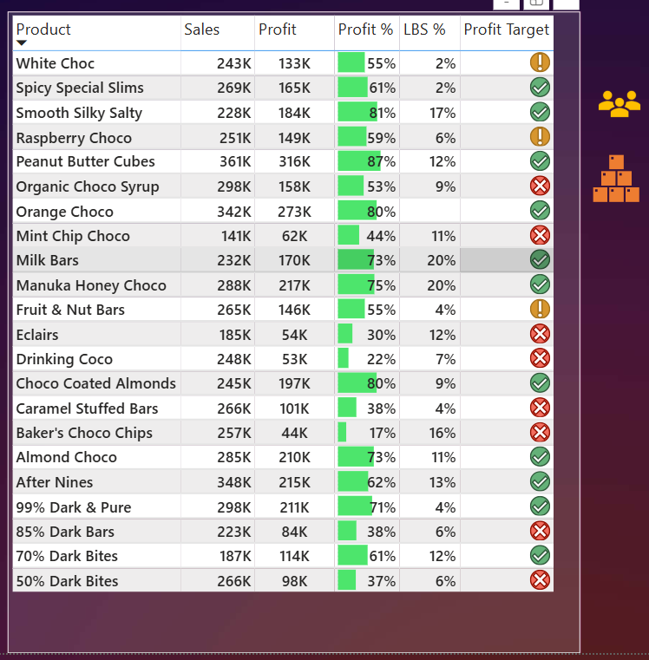
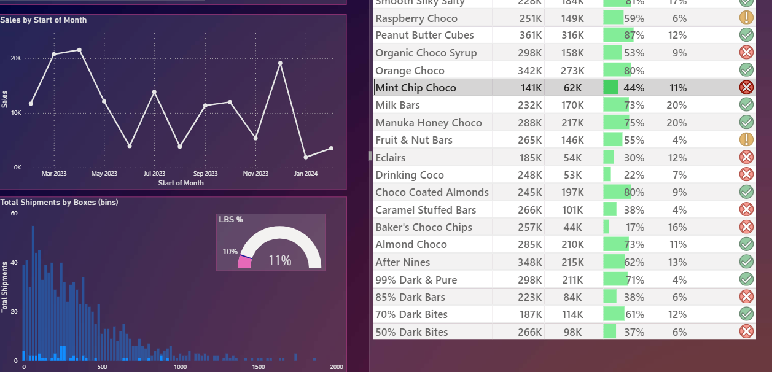

Slide 12
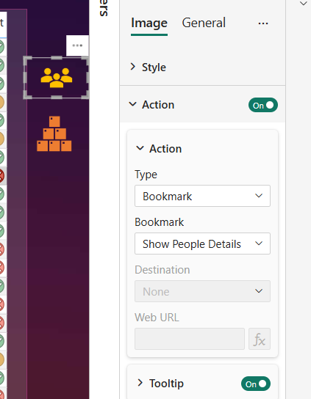
Enhanced Navigation & Usability
Bookmarks were incorporated to enrich user experience by:
Presetting views for common analysis scenarios
Saving filter states for continuity across sessions
Managing challenges tied to bookmark persistence after data refresh

Slide 13
Thank You
I appreciate your time and attention. Please feel free to share any questions, comments, or suggestions. Your insights are valuable in helping us continuously improve.

